Slide 1
Design Project 2 Band Pass Filter
By : Nittala Satya Surya Lakshmi Vasuki Siva Srinivas
#Student Id – 620094
Email – sn620094@wne.edu

Slide 2
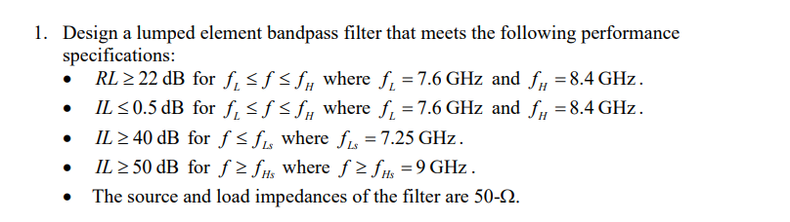

Slide 3
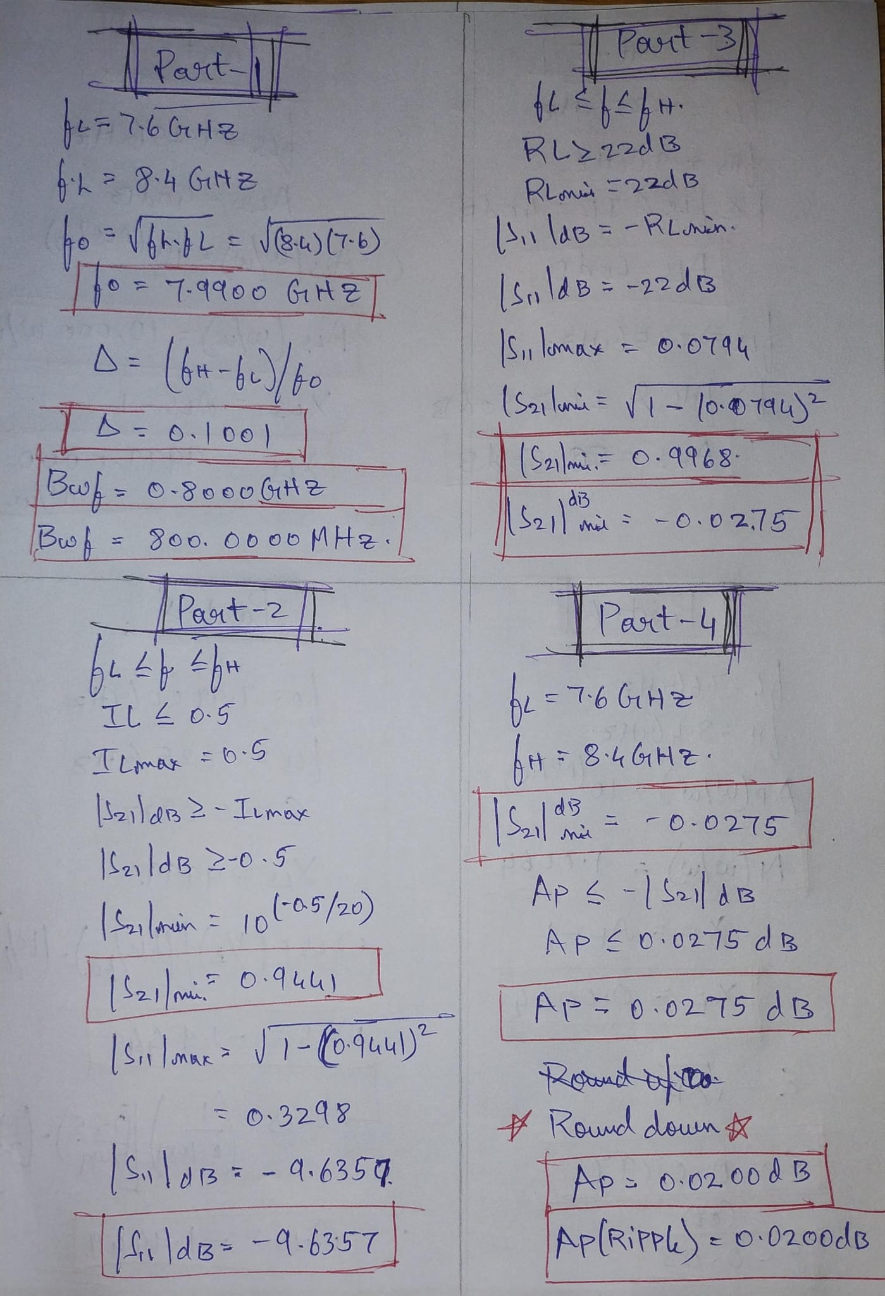
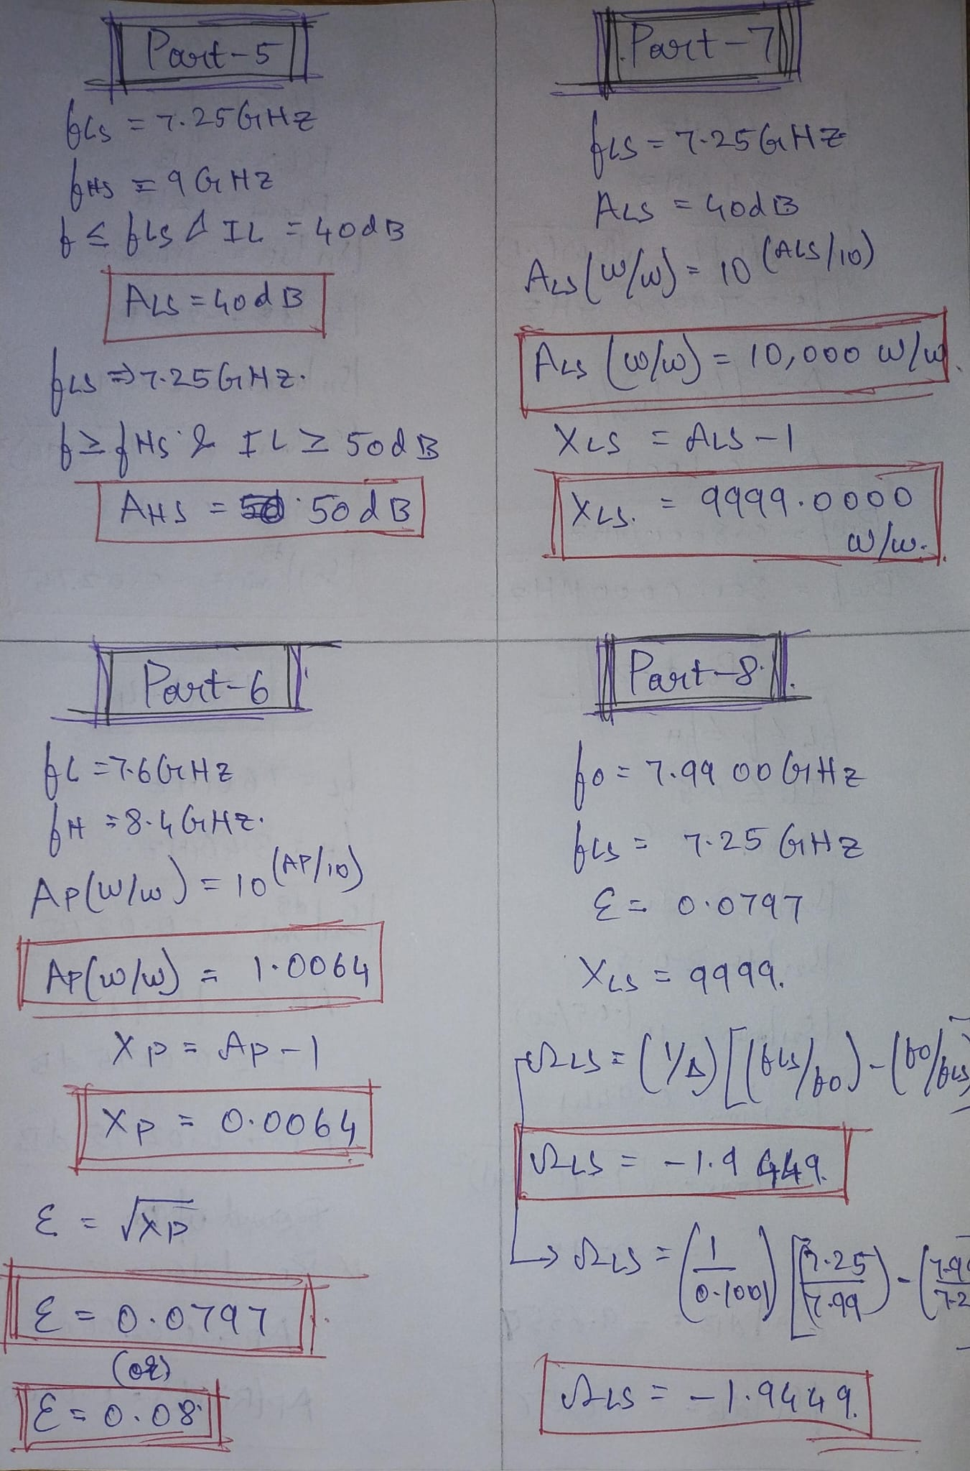
Hand Calculations

Slide 4
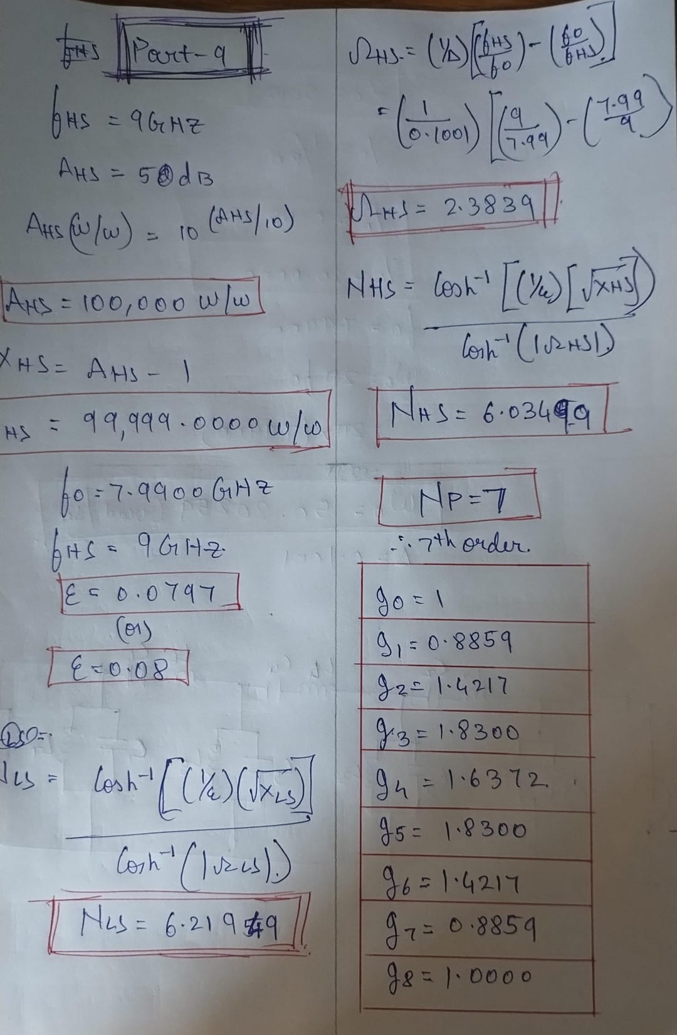
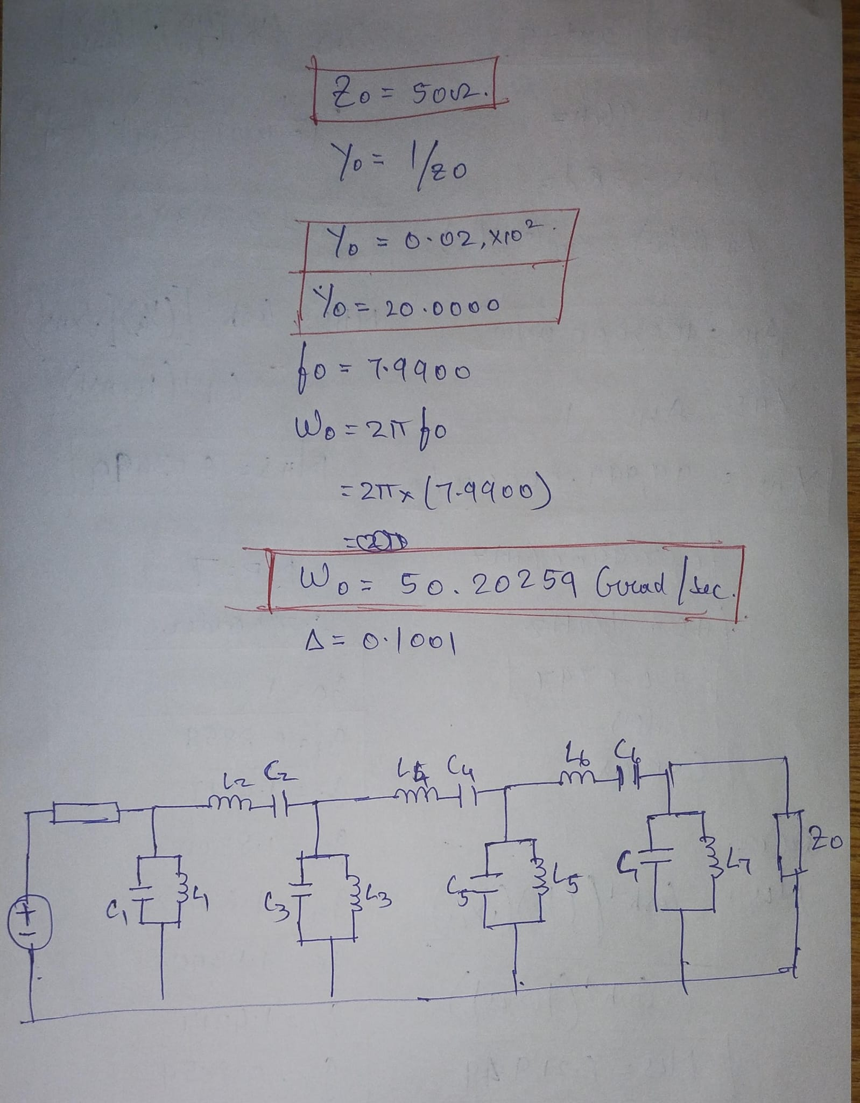

Slide 5
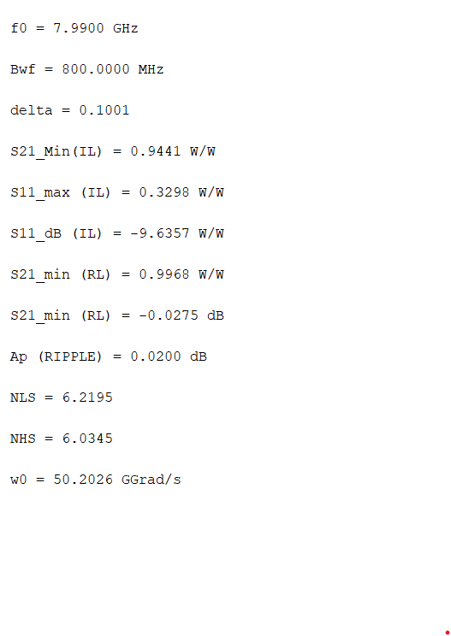
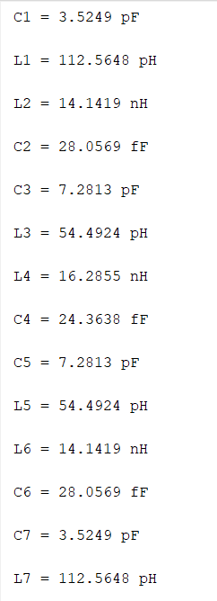
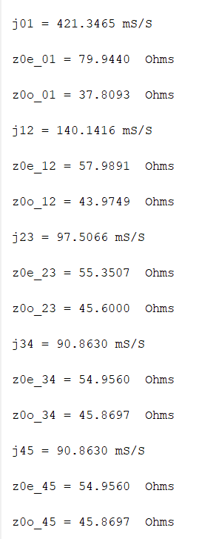
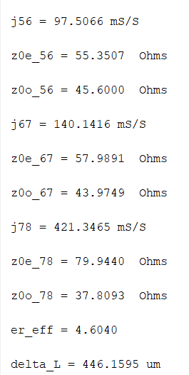

MATLAB Calculations

Slide 6
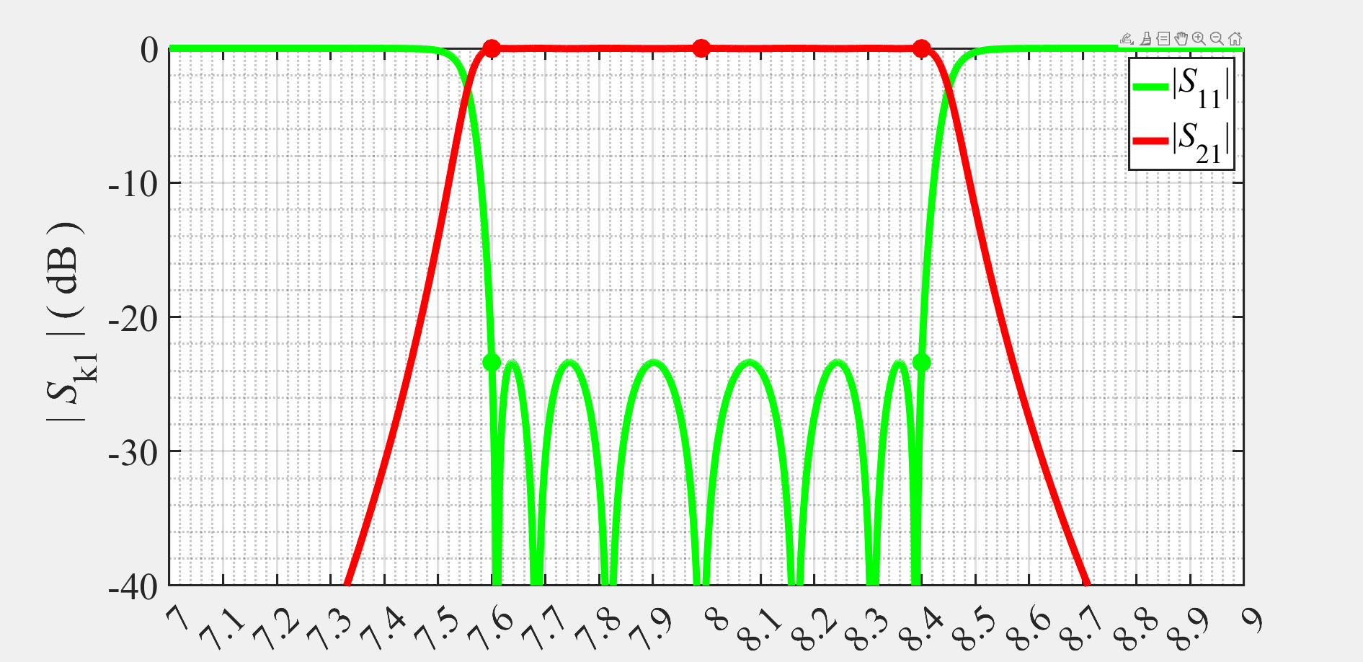
MATLAB Ideal Lumped Elements

Slide 7
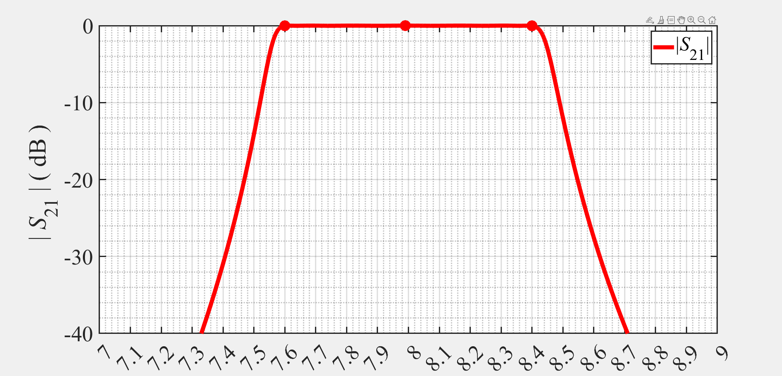
MATLAB Ideal Lumped Elements

Slide 8
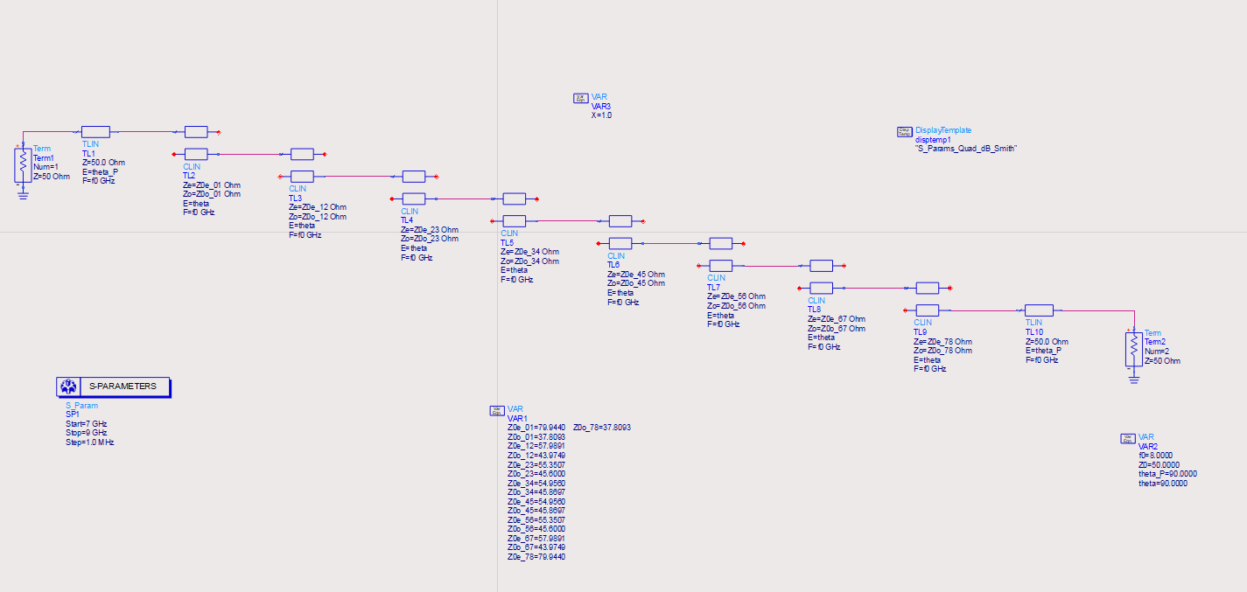
Coupled-Line Bandpass Filter with 90° Feed Lines

Slide 9
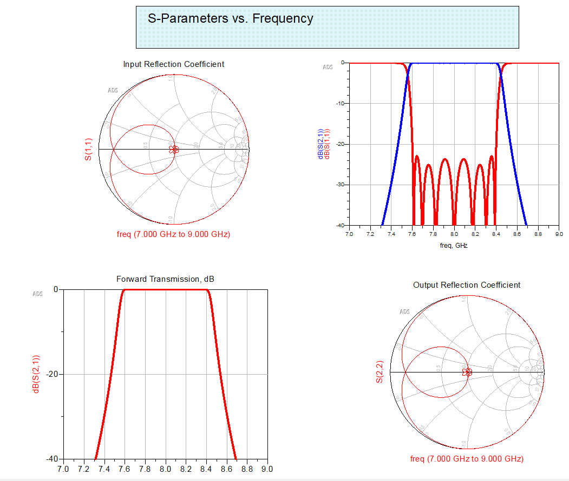
Coupled-Line Bandpass Filter with 90° Feed Lines

Slide 10
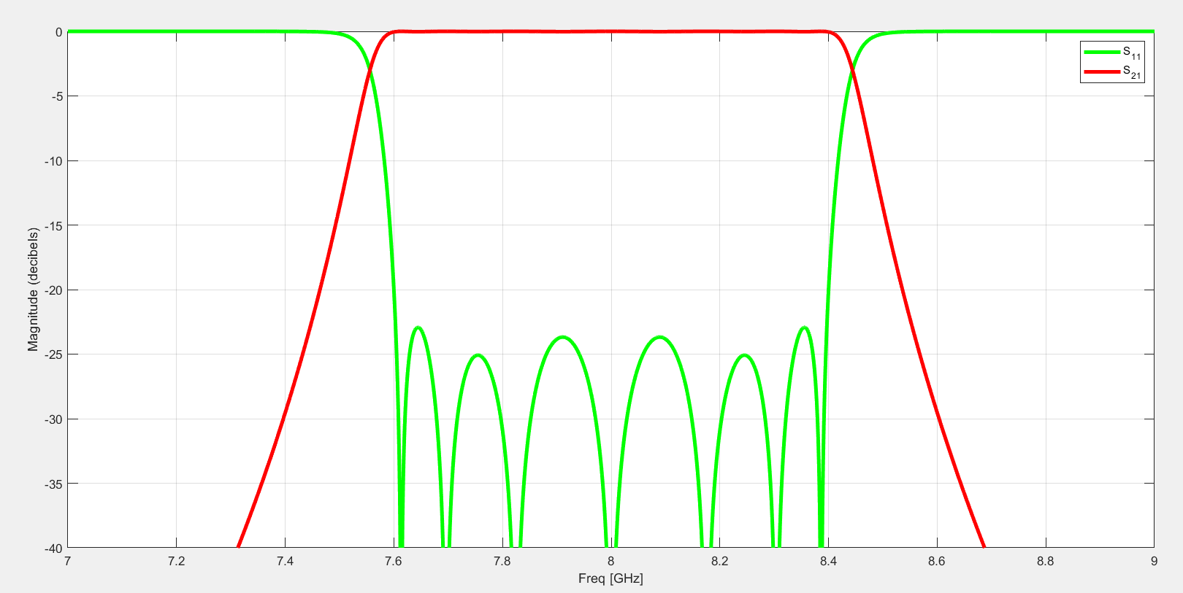
MATLAB Ideal TRL

Slide 11
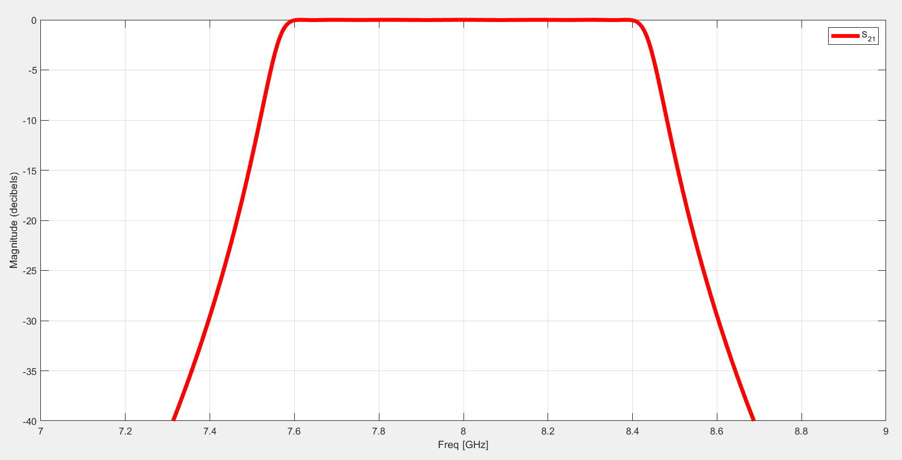
MATLAB Ideal TRL |S21|

Slide 12
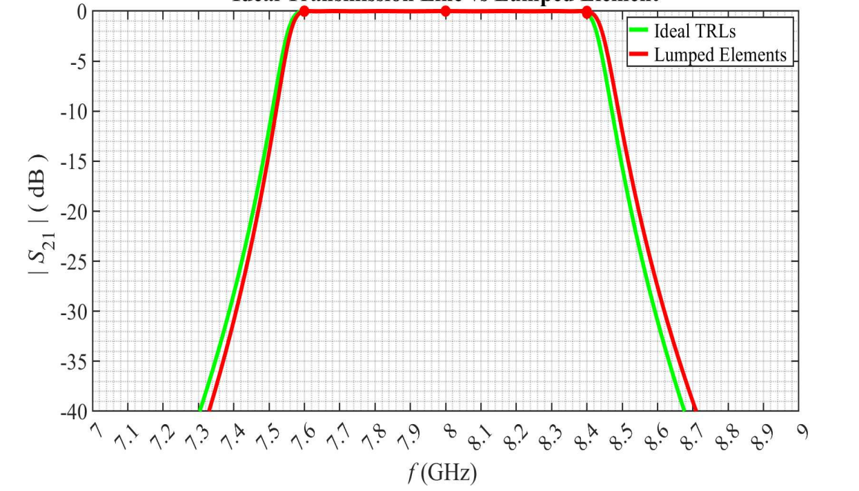
Ideal Transmission Lines vs Lumped Element

Slide 13
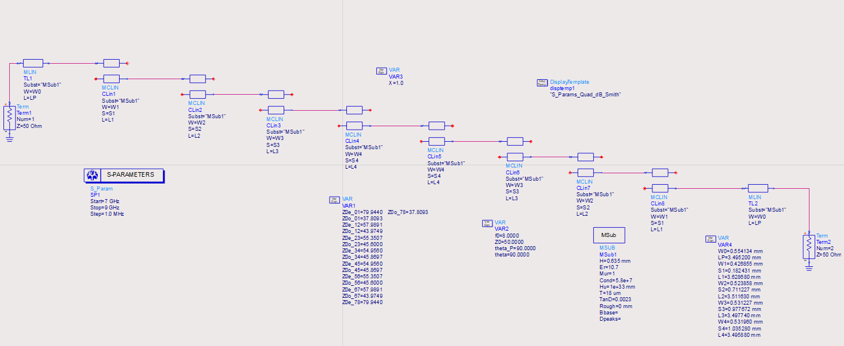
Microstrip Implementation of a Coupled-Line Bandpass Filter

Slide 14
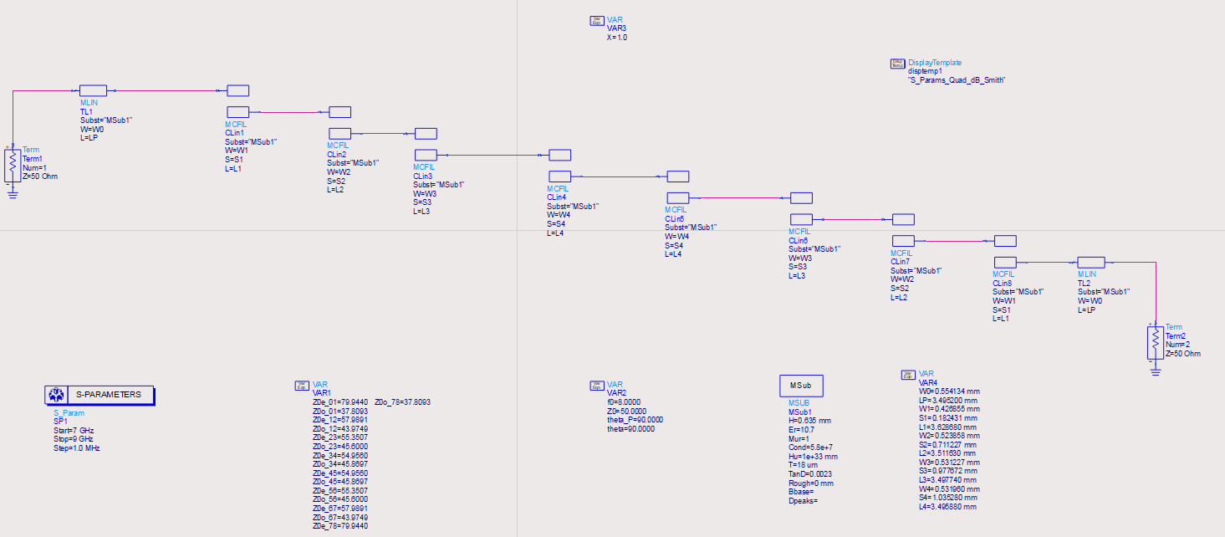
ADS Simulation of a Microstrip Coupled-Line Bandpass Filter (V1) using MCFIL Elements (7 GHz - 9 GHz)

Slide 15
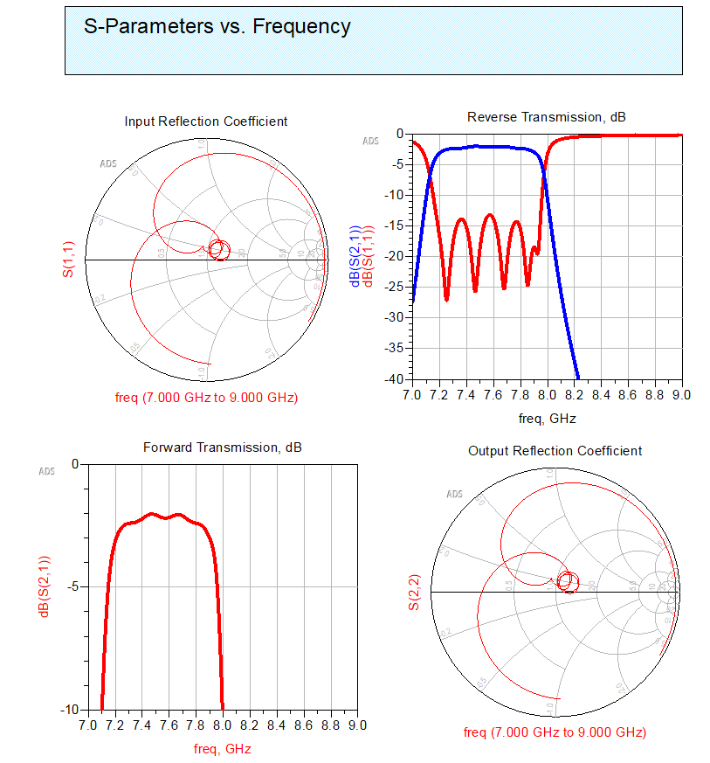
ADS Simulation of a Microstrip Coupled-Line Bandpass Filter (V1) using MCFIL Elements (7 GHz - 9 GHz)

Slide 16
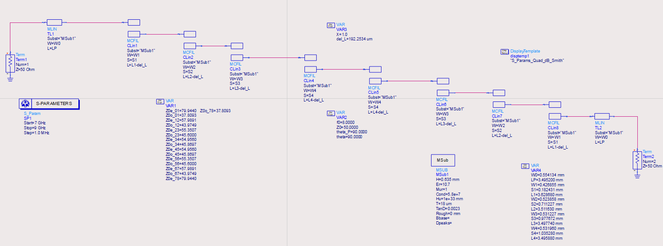
Tuned Microstrip Coupled-Line Bandpass Filter (V2) (7 GHz - 9 GHz)

Slide 17
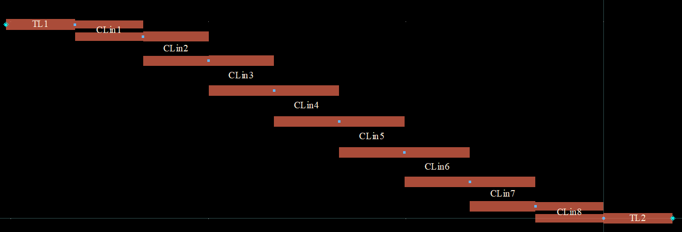
Tuned Microstrip Coupled-Line Bandpass Filter (V2) (7 GHz - 9 GHz)

Slide 18
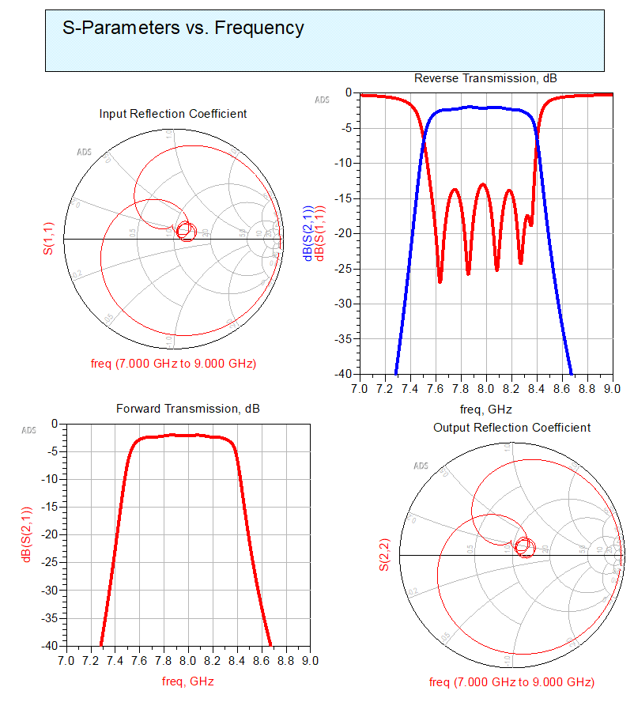
Tuned Microstrip Coupled-Line Bandpass Filter (V2) (7 GHz - 9 GHz)

Slide 19
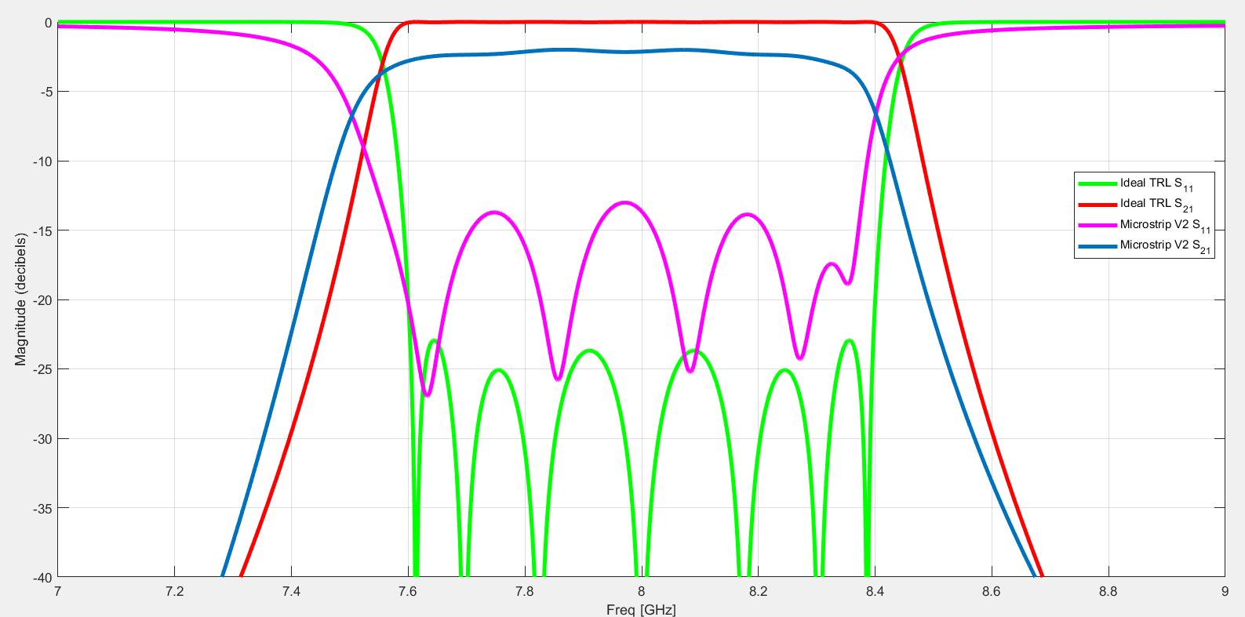
Ideal Transmission Line Vs Microstrip V2

Slide 20
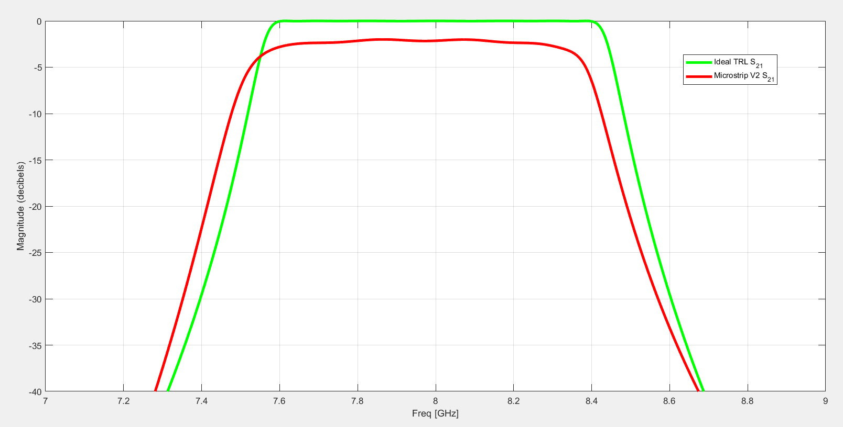
Ideal Transmission Line Vs Microstrip V2

Slide 21
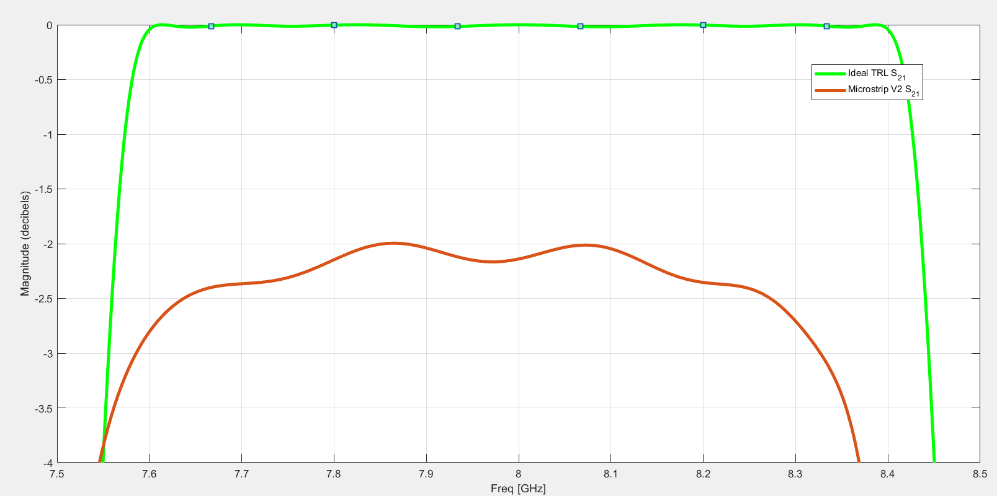
Ideal Transmission Line Vs Microstrip V2

Slide 22
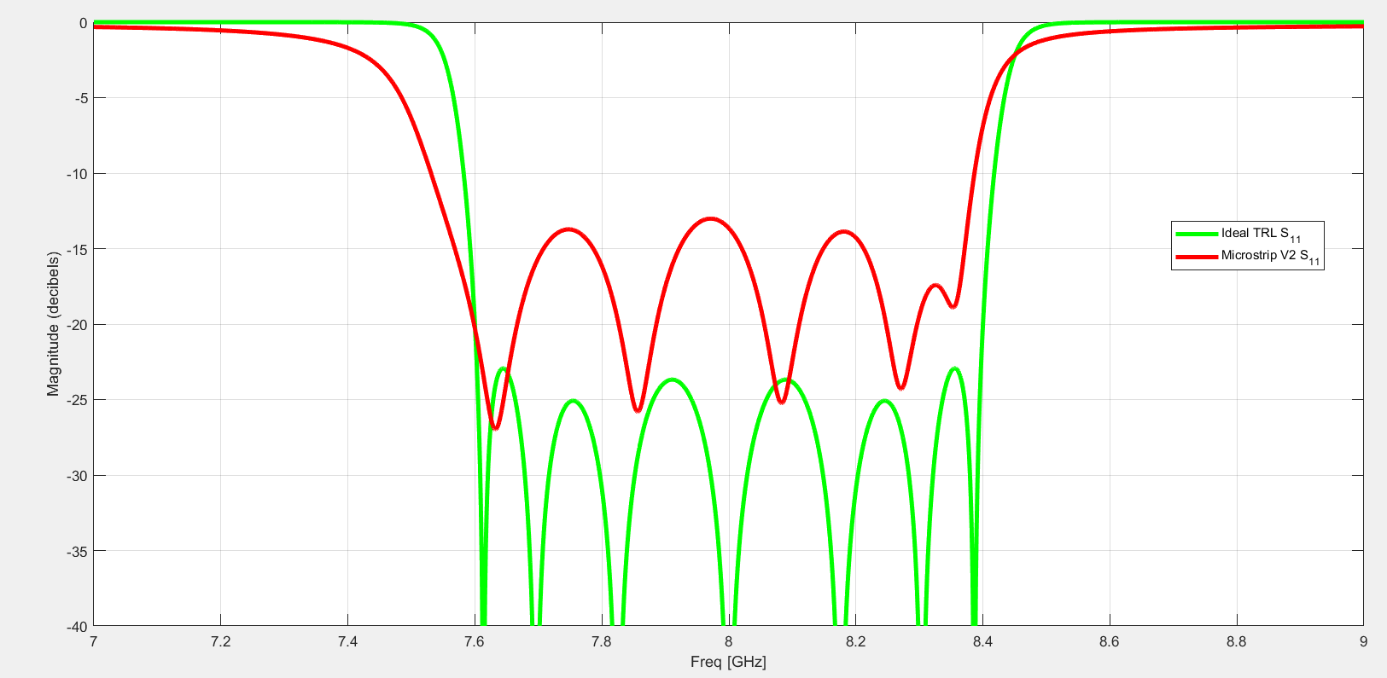
Ideal Transmission Line Vs Microstrip V2

Slide 23
The End

